Slide 1

Accommodation Reservation System
Student Name:
Sudhanshu Biswas
Matriculation: 92128311
Course: Project: Java and Web Development

Slide 2

TABLE OF CONTENTS
Architecture diagram
Purpose
Technology Used
Improvements / Alterations
Demo

Slide 3
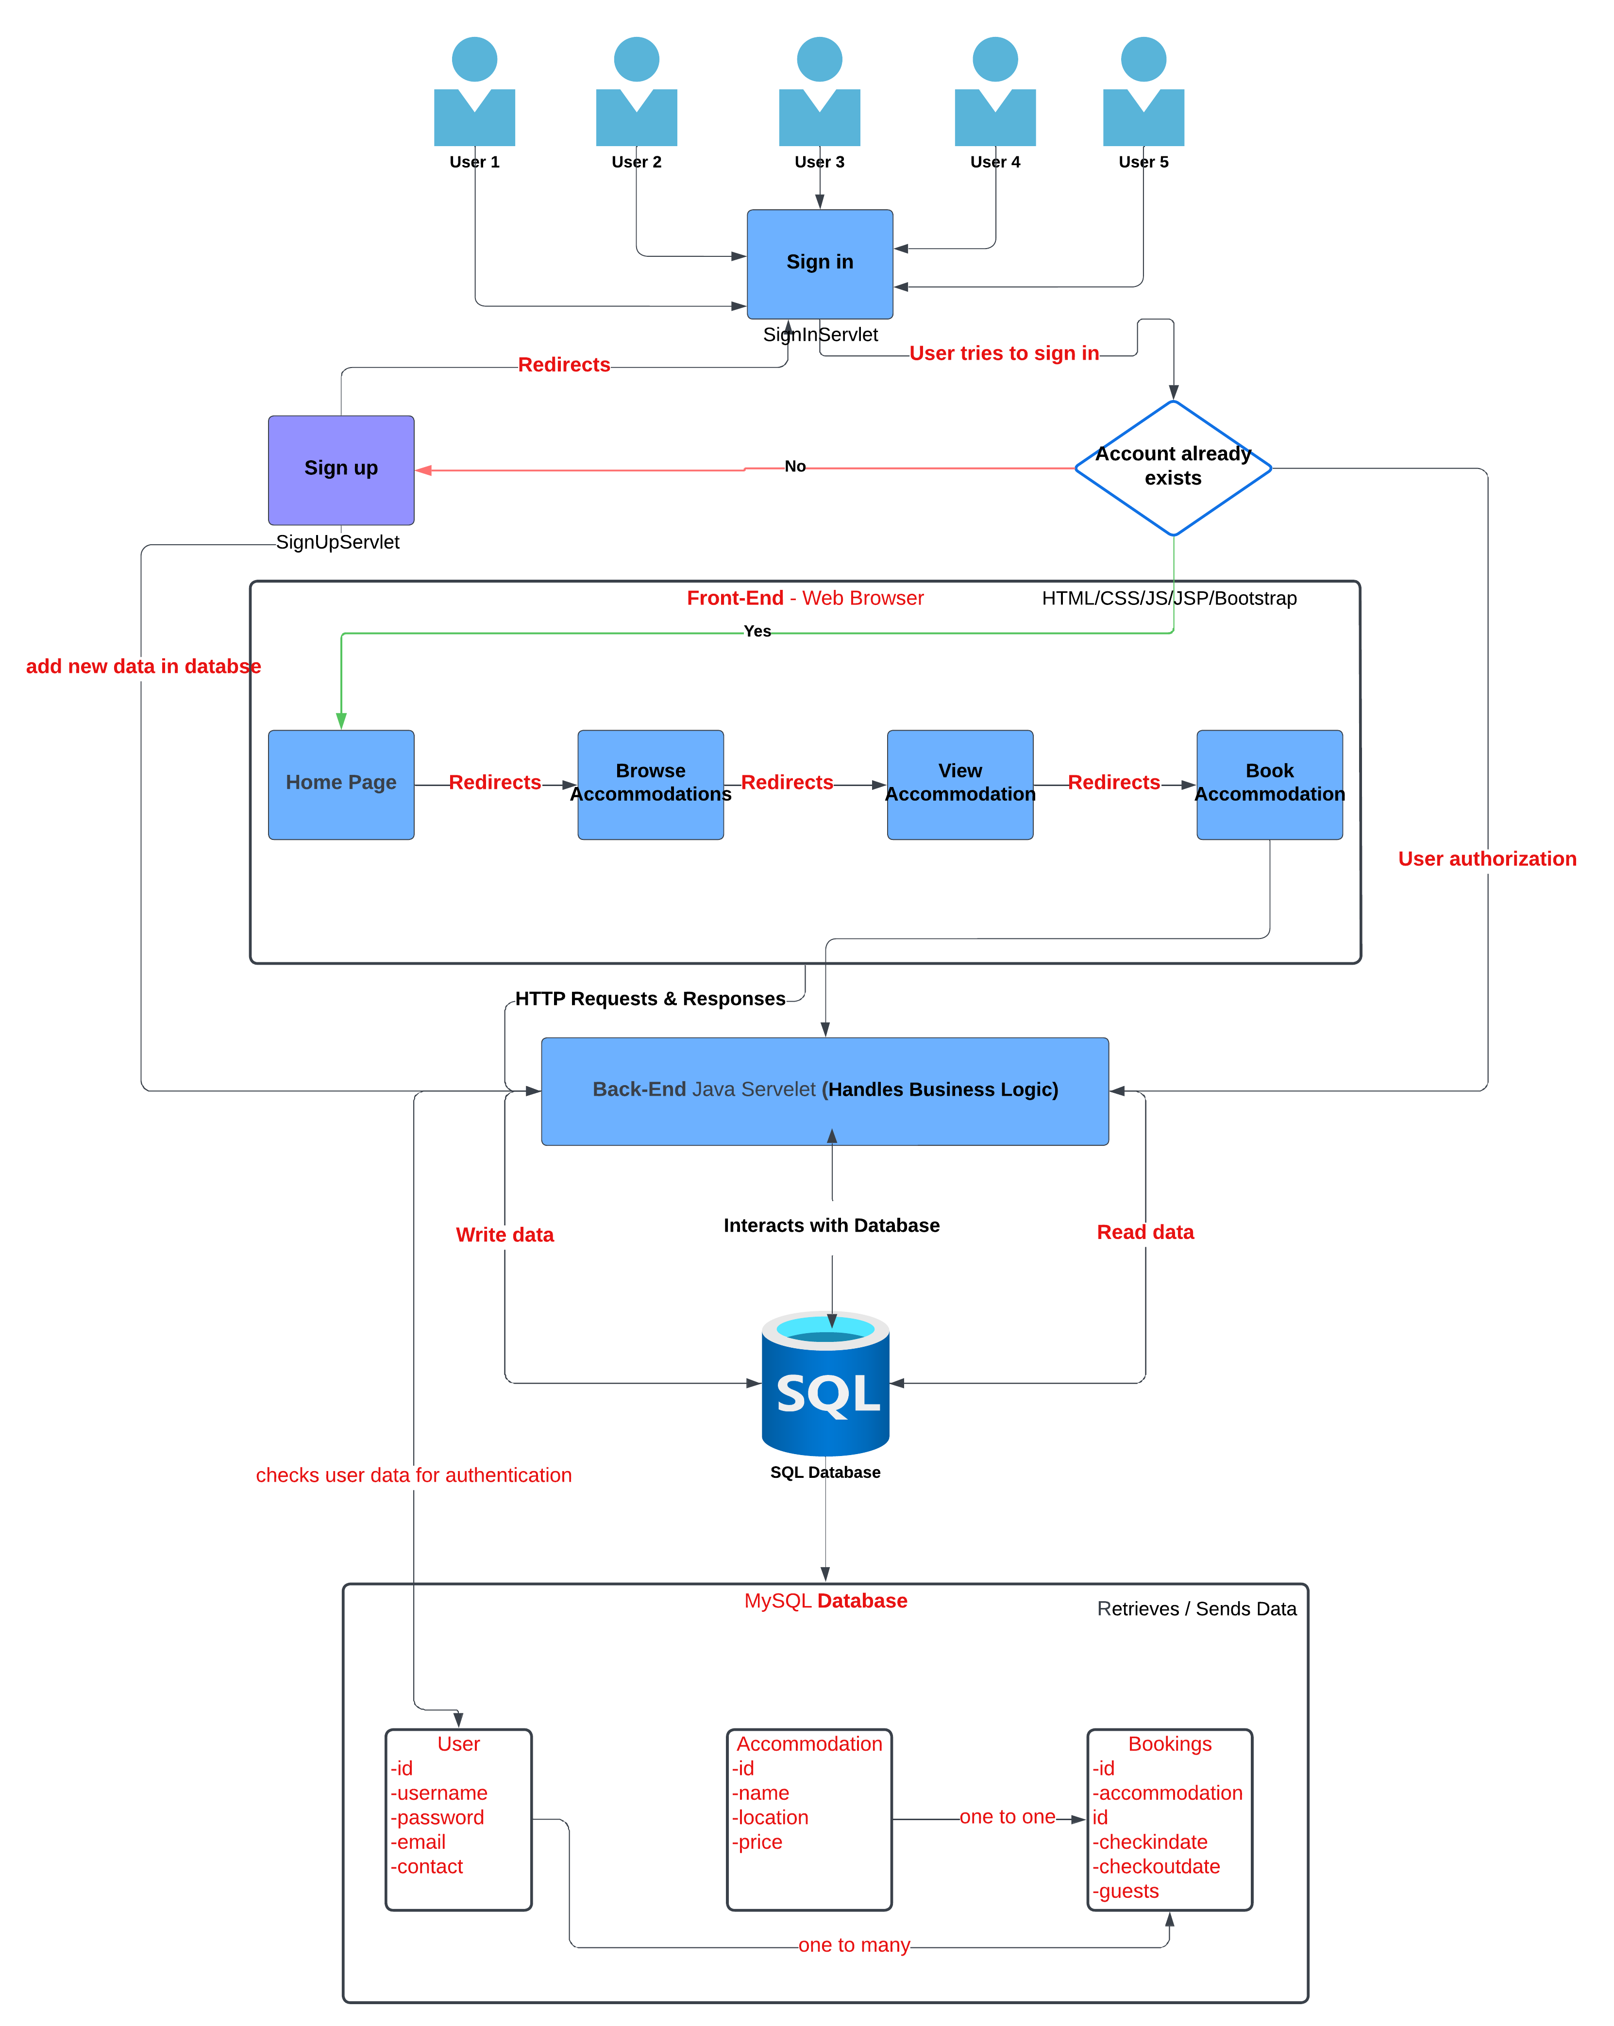
Architecture diagram
Users
Users: Multiple users can access the system.
Sign-Up/Sign-In
Sign Up: New users register, and their details are added to the database.
Sign In: Existing users enter their credentials, which are checked against the database.
Front-End (Web Browser)
SignInServlet: Handles user sign-in, checking credentials against the database.
SignUpServlet: Manages new user registrations, adding new user data to the database.
Home Page: After sign-in, users are redirected to the home page.
Browse Accommodations: Users can browse available accommodations.
View Accommodation: Users view details of selected accommodations.
Book Accommodation: Users proceed to book their chosen accommodation.
Back-End (Java Servlet)
Java Servlet: Handles business logic, processing user requests, and interacting with the database for both reading and writing data.
Database
SQL Database: Stores user information, accommodation details, and booking records.

Slide 4
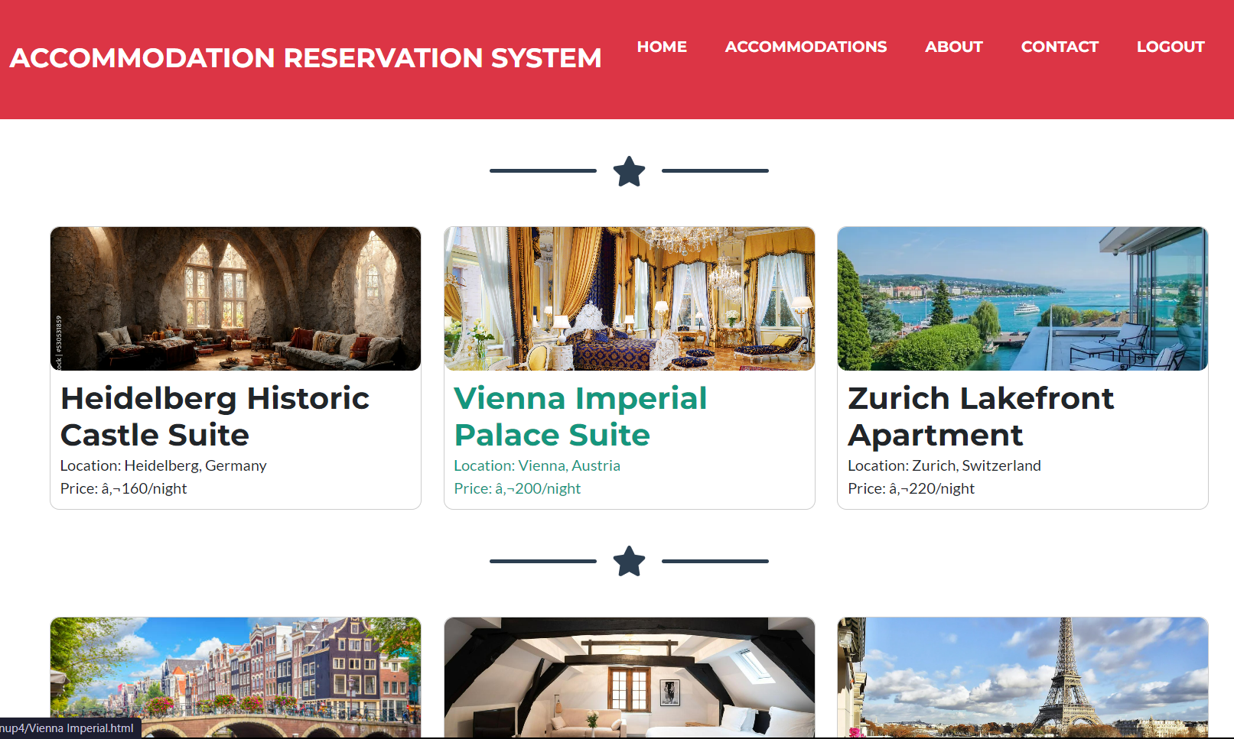
PURPOSE
Accommodation Reservation System

Slide 5

Purpose Of The Web Application:
The Accommodation Reservation System is focused and designed to provide users with a seamless ,pain free and efficient way to book your own, any type of accommodation in just matter of minutes. Users in the web application can browse through a lot of different variety of accommodations , hotels , apartments also there are tropical , natural, trending , county-side , beachfront , cabins, etc. As per the users choice he can choose his preferred location , pricing and amenities the one which suites him and his pocket well. The system is intended to simplify the process of finding and booking accommodations, ensuring a user-friendly experience.

Slide 6
Technology choices/Used: (Front-End)
Structures the content of web pages. Defines the layout of the pages, such as headers, footers, sections, and forms for user input.
A popular front-end framework for developing responsive and mobile-first websites.
Adds interactivity to web pages. Handles dynamic updates, form validations, and user interactions without needing to reload the page.
HTML
CSS
Java-Script
Java Server Pages
Bootstrap
Styles the HTML part of the page and give the more enhancing looks and visual appeal. Also Applies various designs and elements like fonts , colors , layouts, etc.
Generates dynamic content on the server side. Embeds Java code within HTML to dynamically render content based on user actions and server responses.

Slide 7
Technology choices/Used: (Back-End)
Implements the core business logic of the application. Manages data processing, application logic, and integration between different components of the system.
Stores and manages application data. Contains tables for accommodations, user information, and booking records. Supports CRUD (Create, Read, Update, Delete) operations to manage data efficiently.
Java
Servlets
SQL Database
Apache Tomcat
Serve as the controller in the MVC (Model-View-Controller) architecture. Handle client requests, process them, and generate appropriate responses by interacting with the business logic and database.
Serves as the web server and servlet container. Hosts the application, handles HTTP requests from clients, and routes them to the appropriate servlets for processing.

Slide 8
An Actual Look of the Web Application.

Slide 9
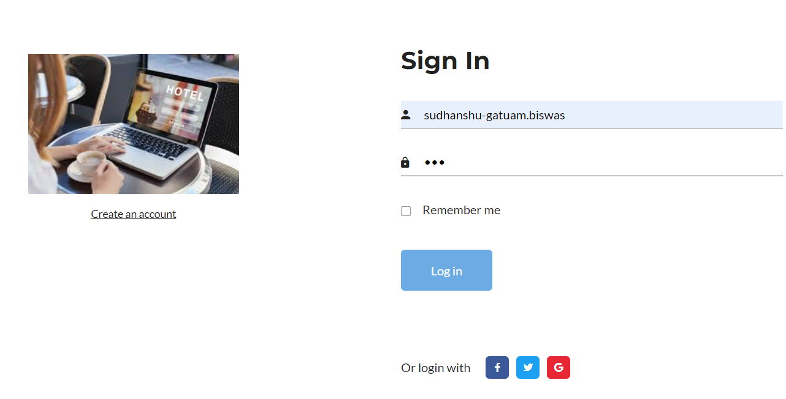
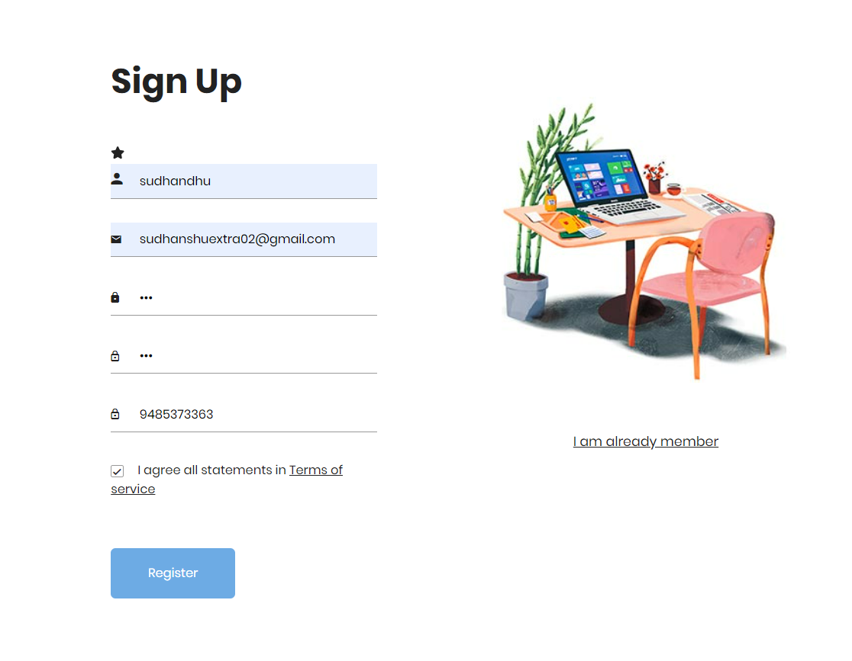
Phase 1 – Sign up & Sign-in
This sign-in page is designed for returning users. It features fields for entering the user's name and password. This page is shot and simple just enter the name and password and that’s it!
The sign-Up page where users can register by entering their name, email, password, phone number, and agree to the terms of service. This page allows new users to register for an account, which is necessary for booking accommodations and accessing other personalized features.

Slide 10
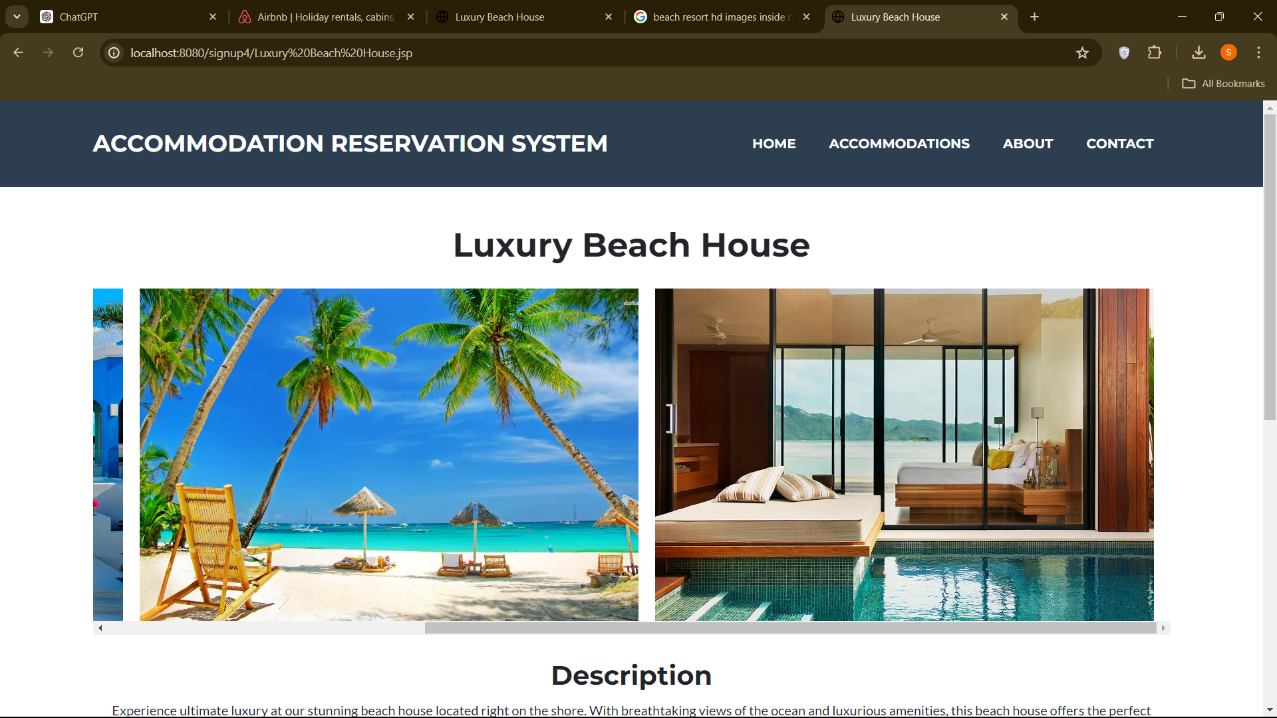
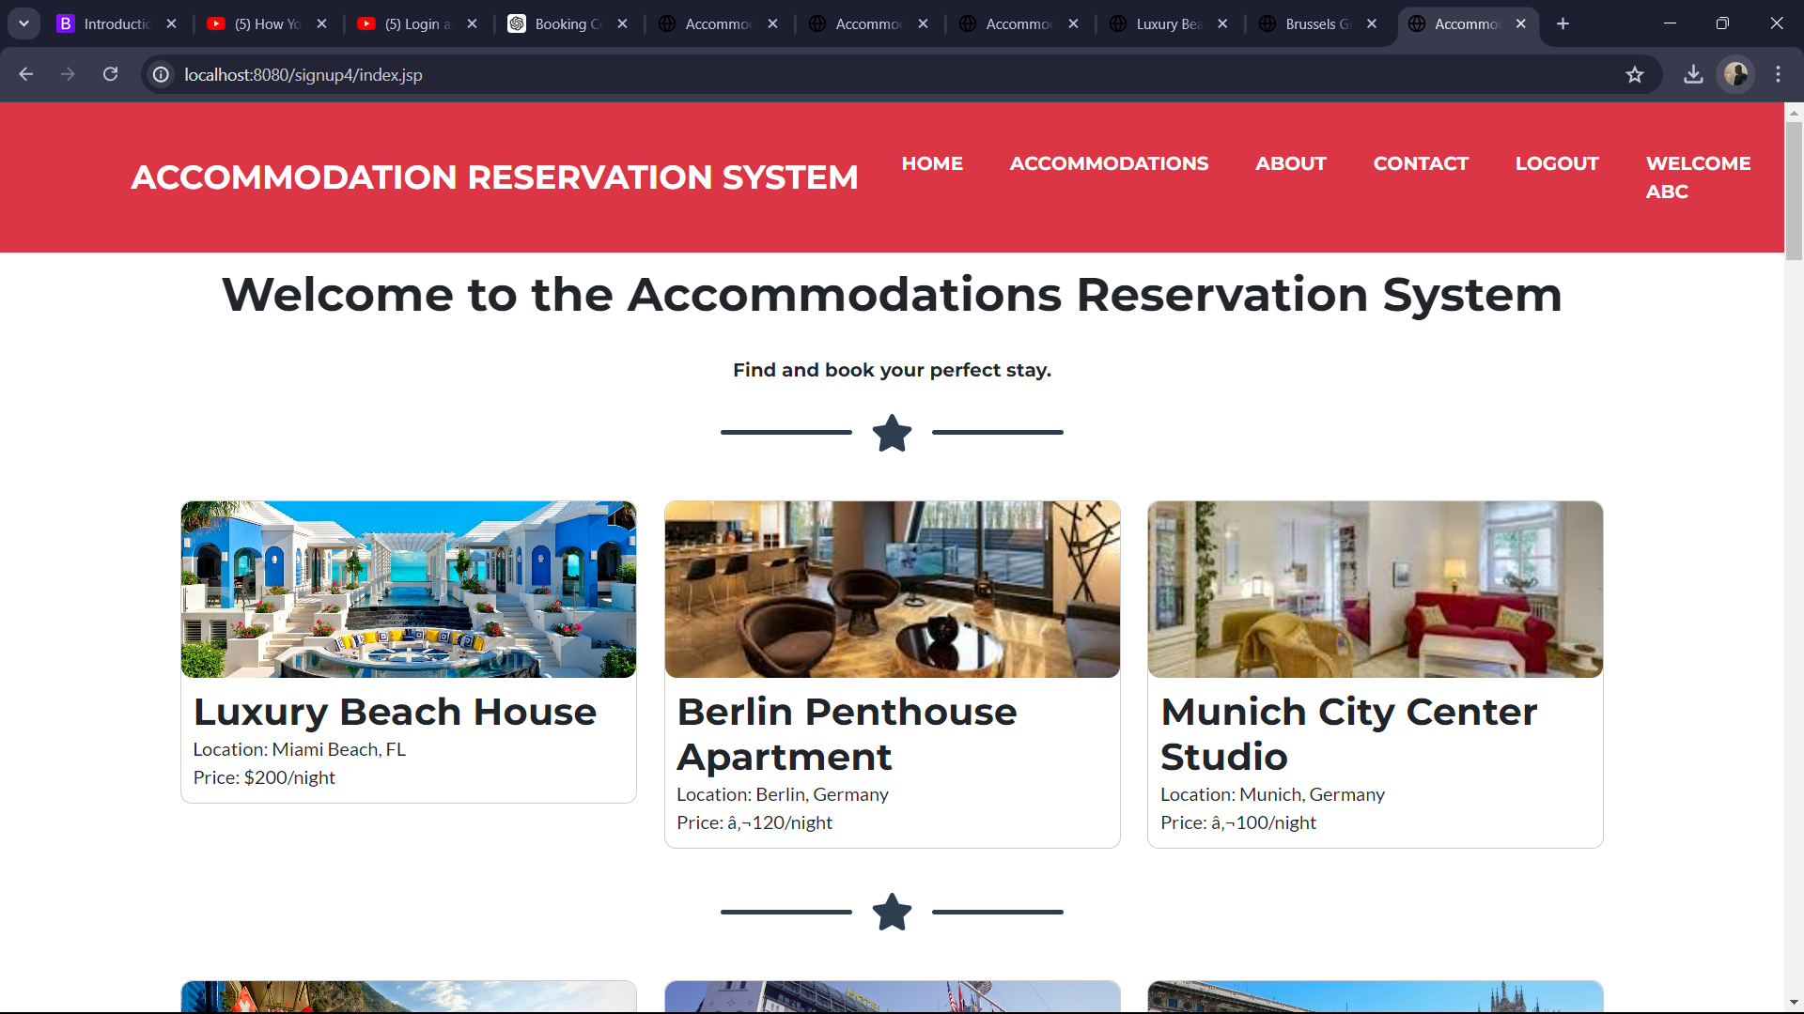
Phase 2 – Accommodation & Booking
A detailed view of the "Luxury Beach House" accommodation. There are also the images of the accommodation. Below the images, there is detailed description highlighting the luxury amenities and features. This page provides potential guests with comprehensive details about a specific accommodation, helping them make informed decisions about their stay.
Accommodation Reservation System" is displayed. It welcomes users with a bold header and a search tagline, "Find and book your perfect stay. This page serves as the landing page, giving users a glimpse of the accommodations available and encouraging them to explore more.

Slide 11
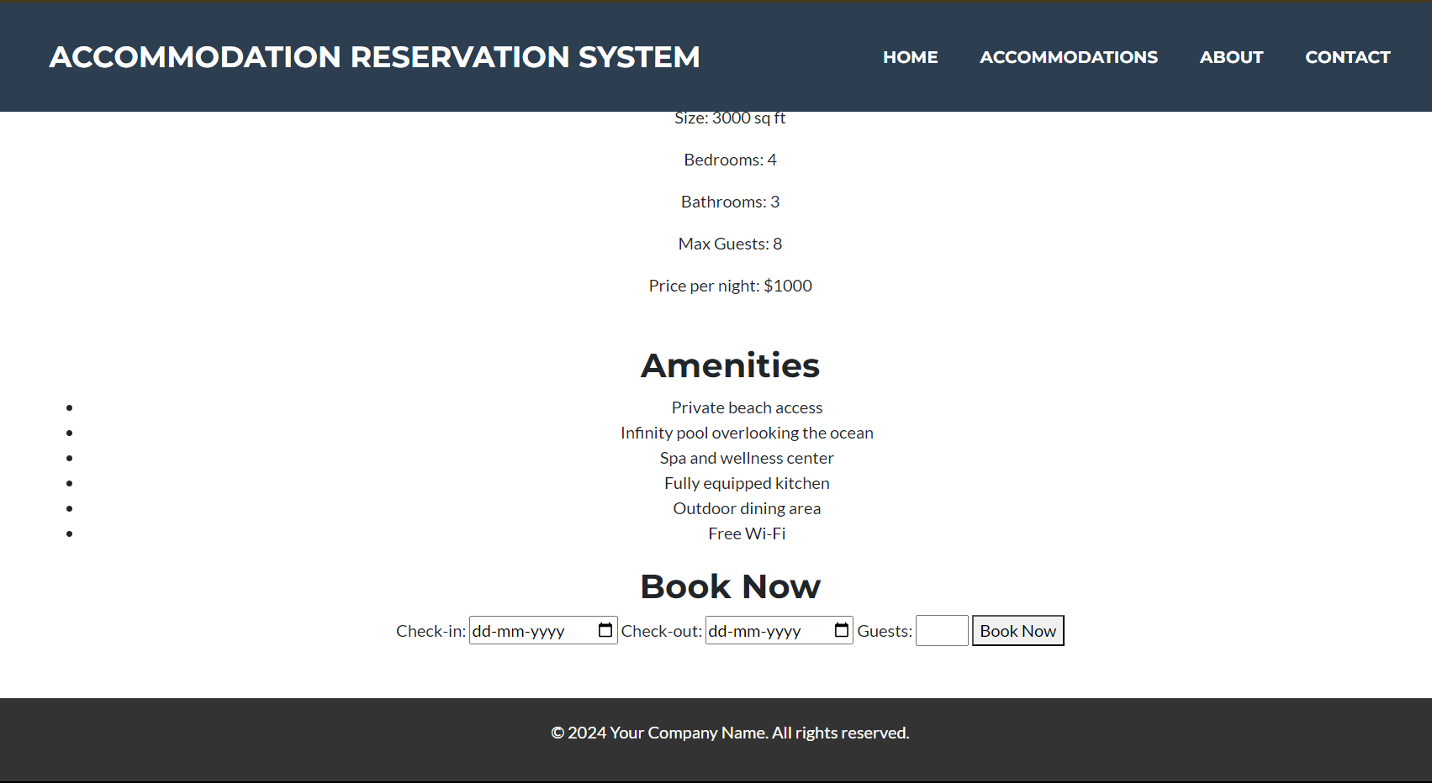
Phase 3 – Confirm Booking
Continuing from the previous image, this section lists detailed specifications such as size, number of bedrooms, bathrooms, maximum guests, and price per night. It also lists the amenities offered. There is a "Book Now" section where users can enter their check-in and check-out dates and the number of guests to make a reservation. This section focuses on the practical details and booking functionality, allowing users to finalize their accommodation choices and make reservations directly.

Slide 12
Improvements / Alterations
Aspects | Old Proposal | Changes | Reasoning
Target User Group | Tourists, travel agents, event organizers | Tourists Only | Focusing on tourists simplifies the application's design and features.
Booking Process | Detailed multi-step form | Simplified single-step form | Streamlined the booking process
User Authentication | Email/password, social media login | Email/password only | Simplified authentication method to enhance security and reliability.
User Roles | Admin, user, travel agent | User Only | Removed travel agent role and Admin to streamline user management and focus on key user groups.
User Interface | Basic HTML and CSS | Enhanced UI with modern frameworks (Bootstrap) | Improved user experience with a more responsive and aesthetically pleasing design
Third-party Integrations | Google Calendar integration | Removed | Simplified the system to focus on core features

Slide 13
Demo

Slide 14

THANK YOU
Student Name:
Sudhanshu Biswas
Matriculation: 92128311
Course: Project: Java and Web Development

